Slide 1

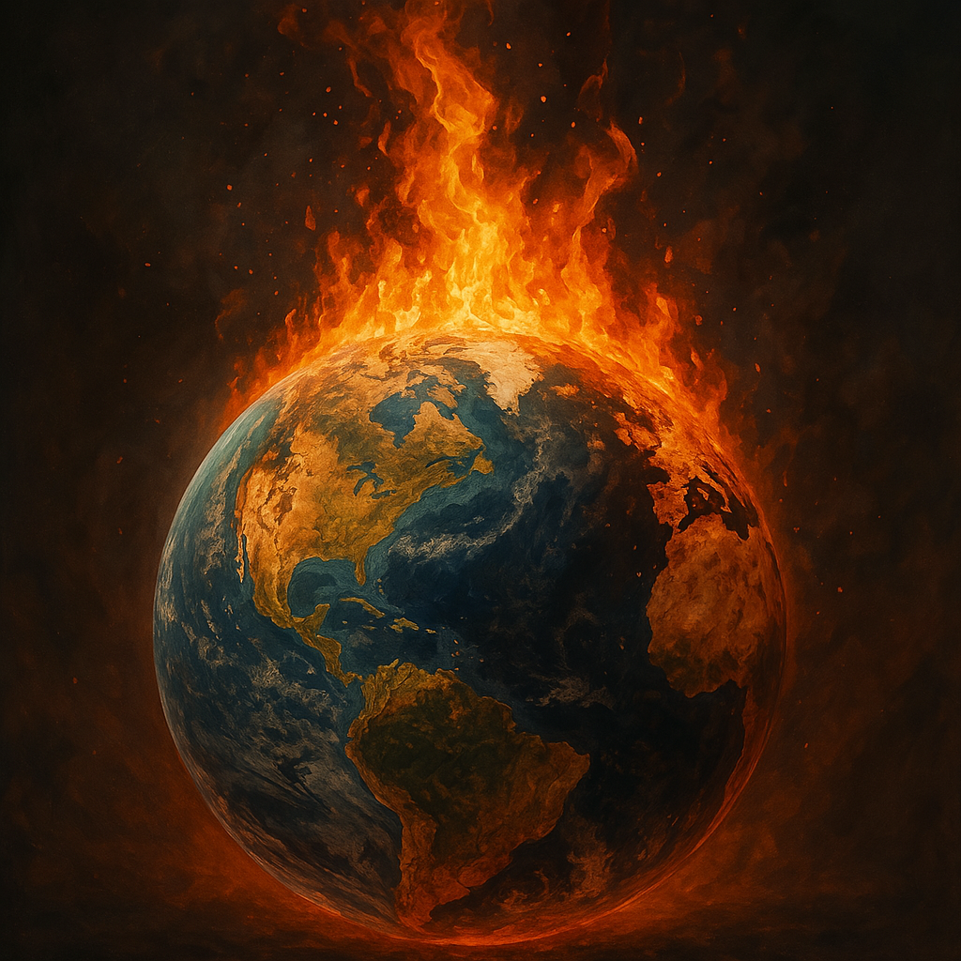
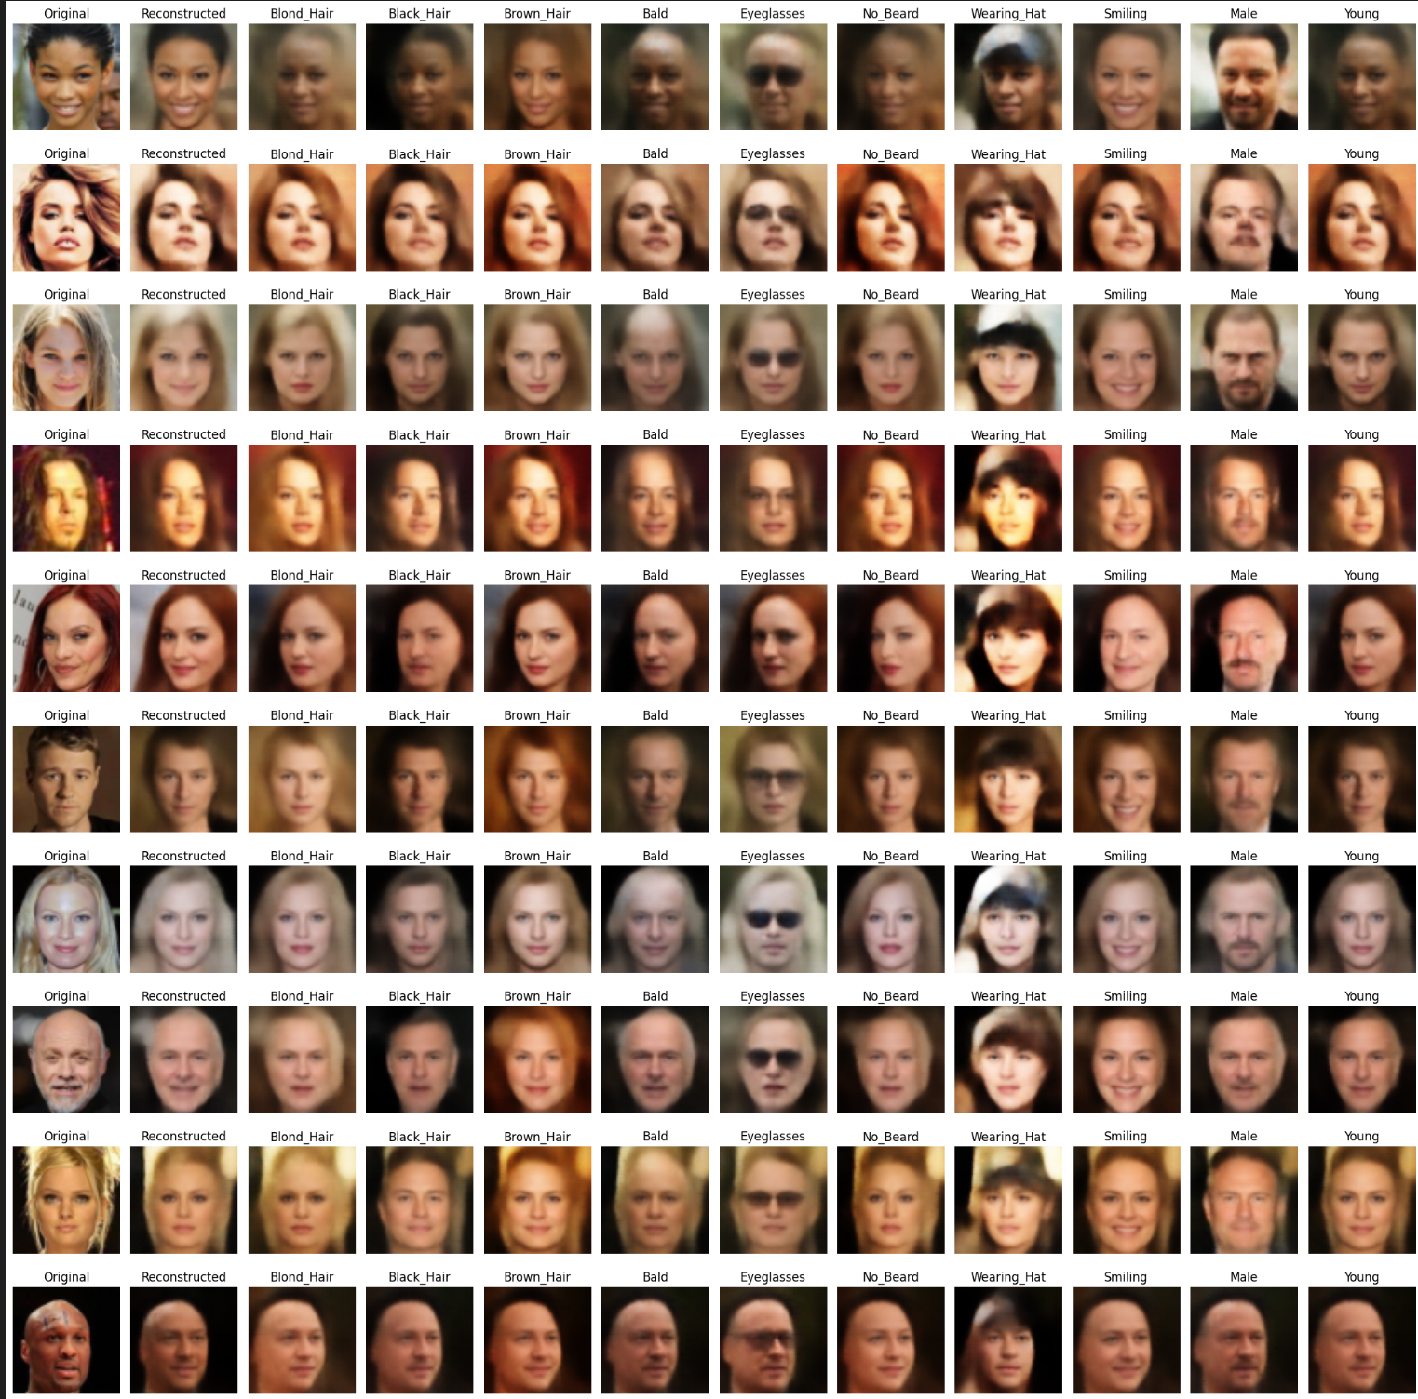
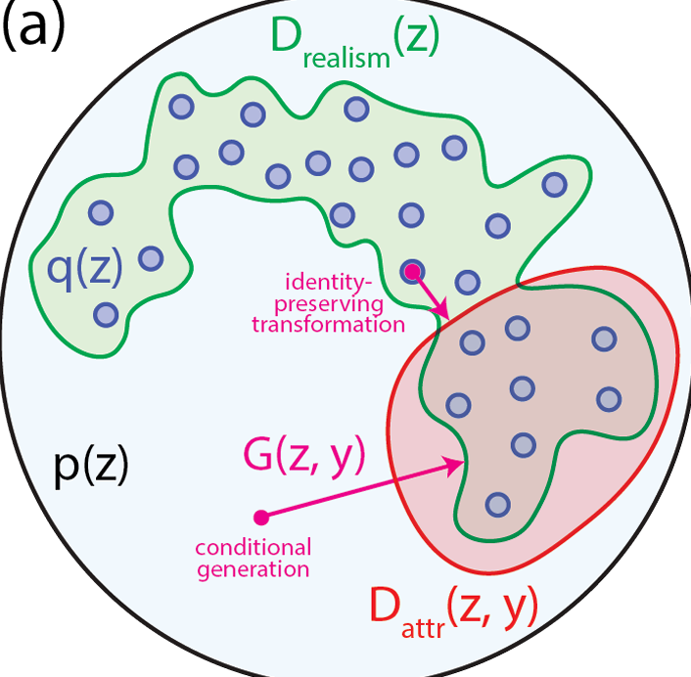
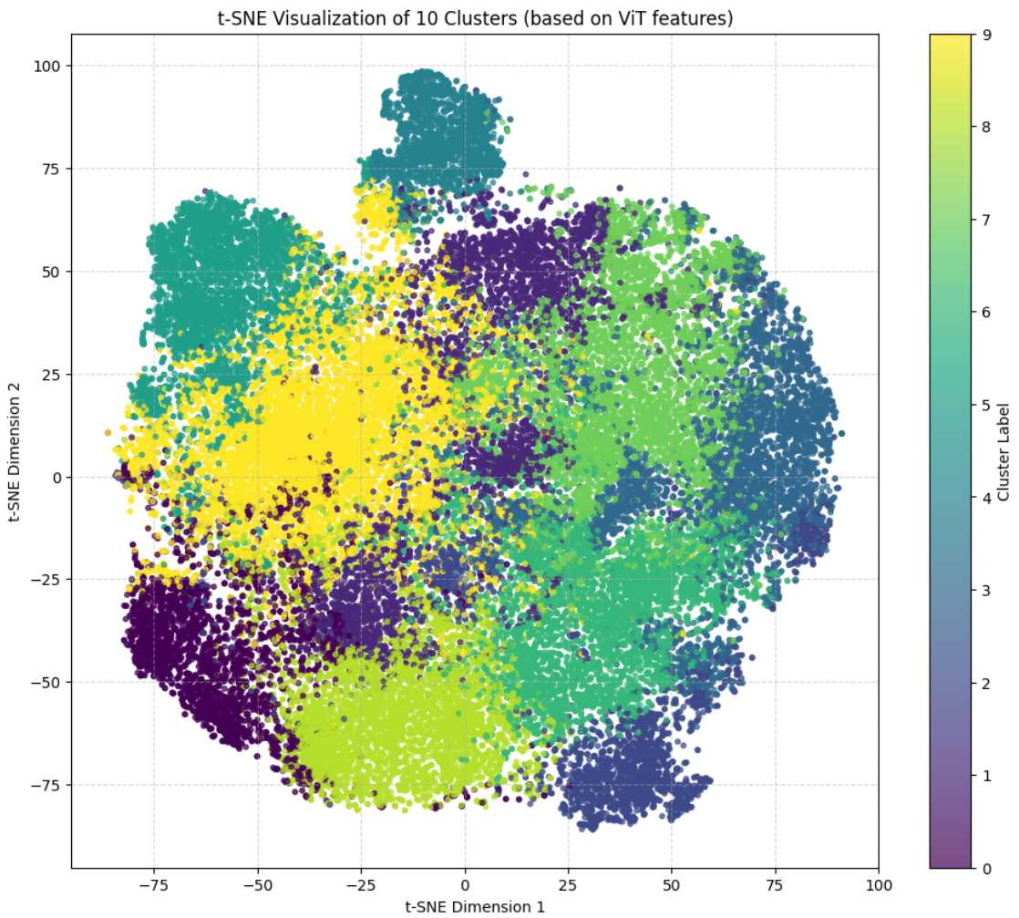
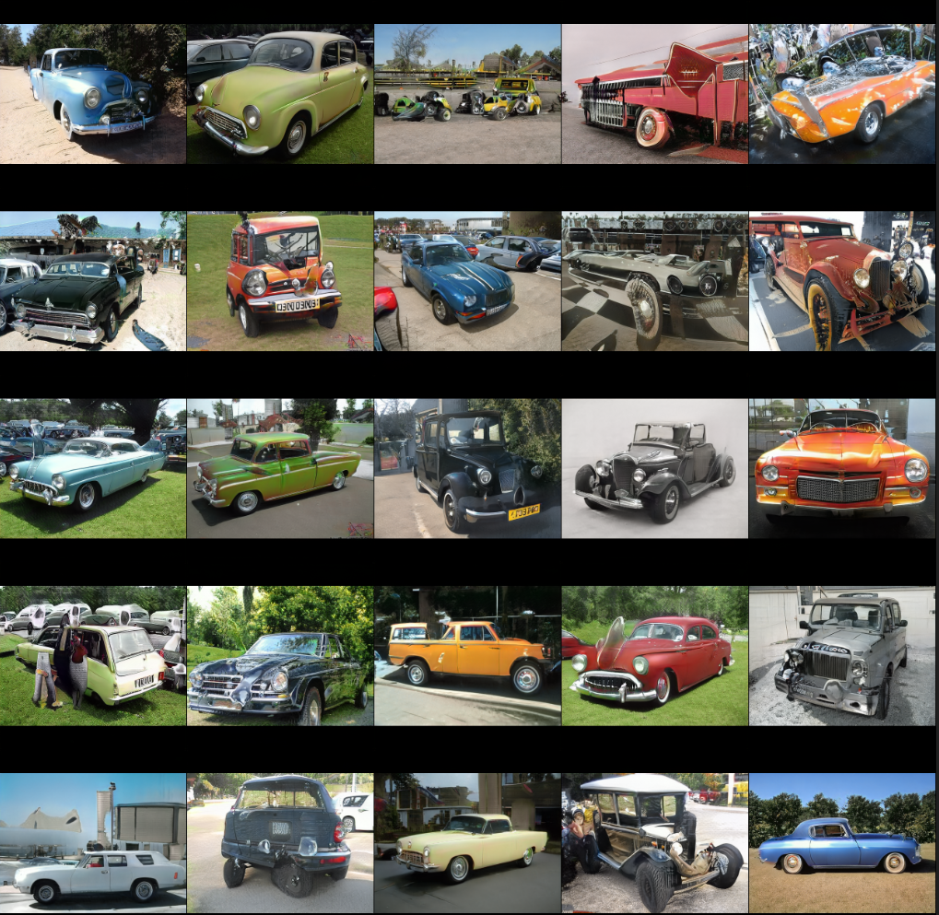
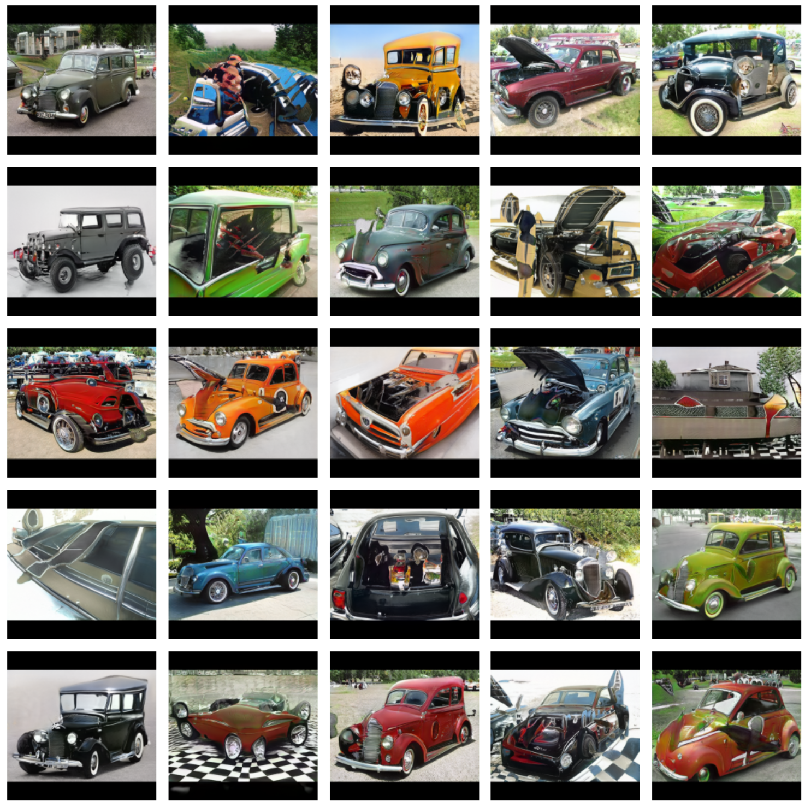
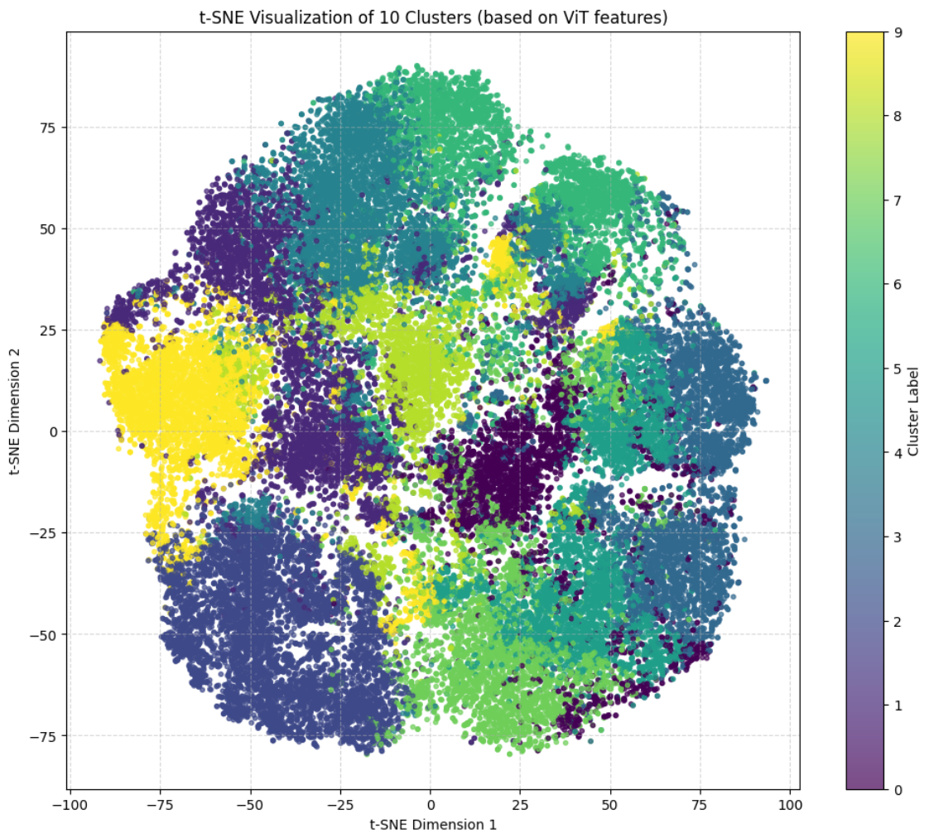
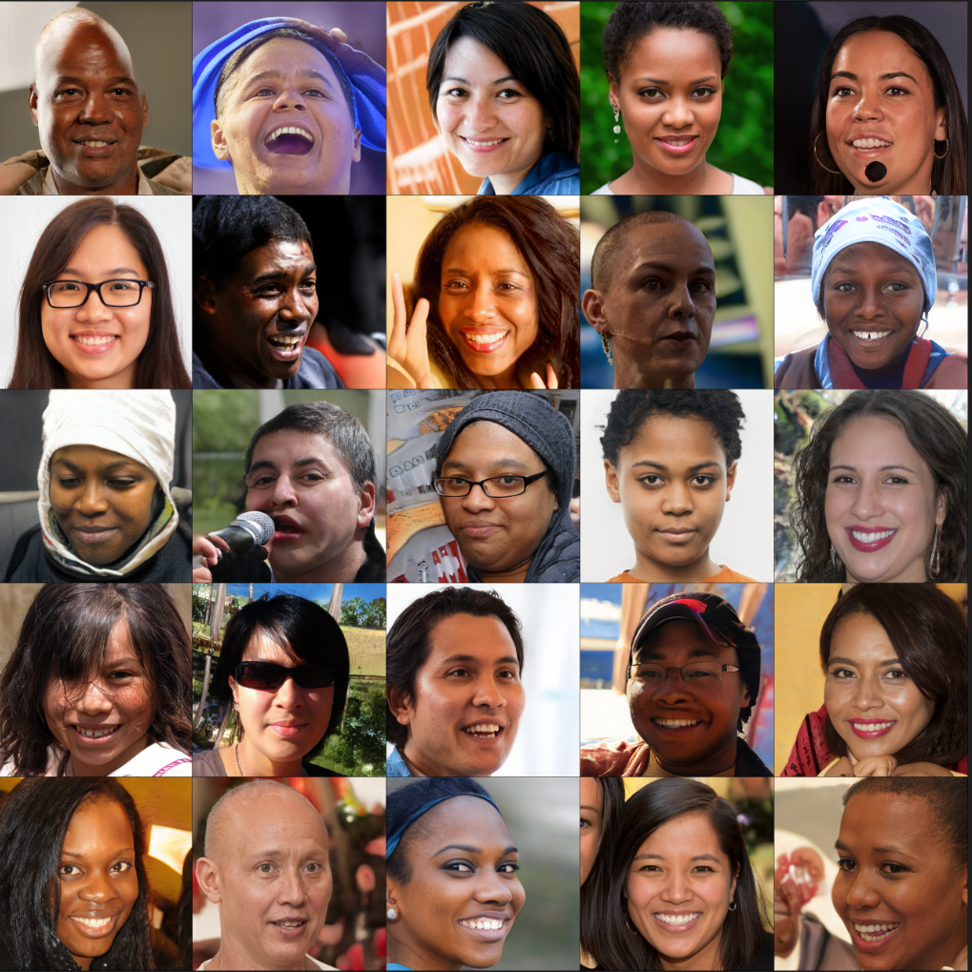
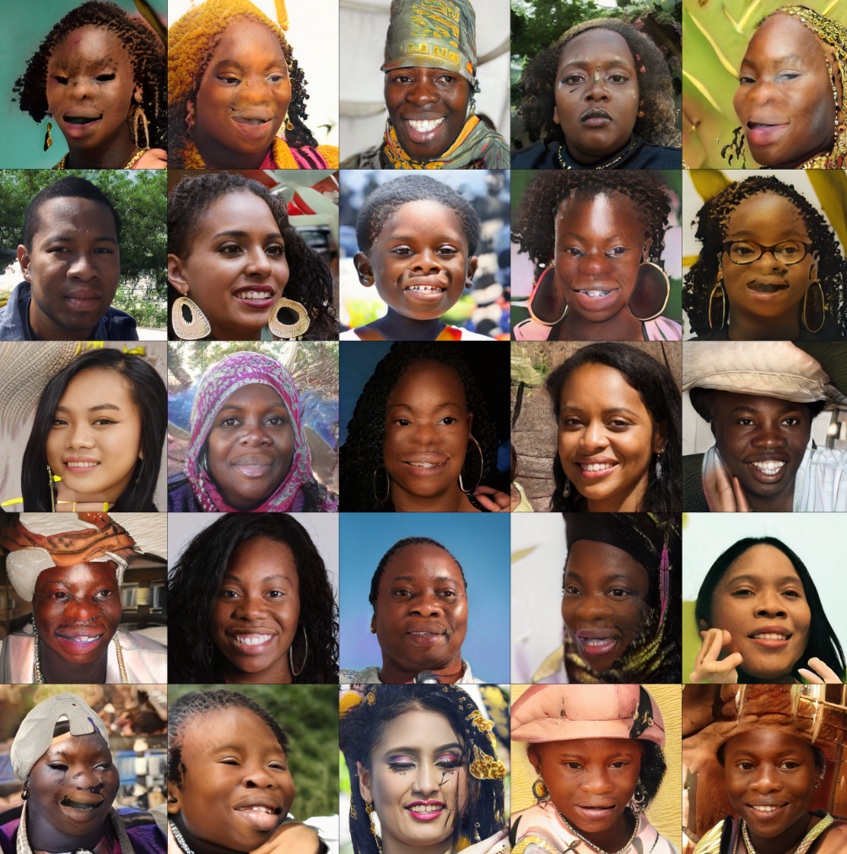


Conditional Generation from Unconditional Generative Models
Haarit Chavda (23110077)
Mentors: Prof.Shanmuganathan Raman , Prajwal Singh
PROBLEM STATEMENT
VAE - CelebA
Methodology:
Base Model (VAE):
Trained to capture the underlying data distribution with an emphasis on reconstruction quality. The trained VAE establishes a semantically structured latent space that serves as the foundation for subsequent conditional transformations.
Latent Actor-Critic Pair:The actor network (a GAN-like model) is trained in latent space to shift latent encodings such that desired attributes are emphasized. The critic network learns to evaluate the realism of these modifications in latent space, ensuring that shifts do not compromise the overall image fidelity. A distance penalty is applied to minimize unnecessary deviations, thus preserving the original identity of the subject.
Save compute and time
Understanding the latent space structure of generative models
Conditional Generation without retraining
Leverage Existing unconditional models
Preservation of identity in transformation
Results:
VAE Training Time: 64,570 seconds
Actor-Critic Pair Training Time: 11,167 seconds
Attribute Conditioning:Targeted modification for 10 prominent attributes (e.g., hair color, facial hair, eyeglasses,etc.).
The actor-critic framework successfully altered only certain features (such as the addition of glasses or changes in hair style/color) while keeping the facial identity preserved.
Approach
StyleGan2
p(z) : Prior Distribution
y : Attributes of data
G(z,y): Actor function
Drealism(z):Realism Constraint
Dattr(z,y): Critiq function
Methodology
Image Generation: Use a pre-trained StyleGAN2 model (e.g. Car Config E) to generate an initial dataset of 10,000 images.
Feature Extraction:Apply a Vision Transformer (ViT) to extract high-level visual features from the generated images.
Clustering via K-means:Perform K-means clustering on the extracted features to group similar types of cars.Each cluster ideally represents a distinct car type, effectively partitioning the latent space into meaningful subregions.
Latent GAN Training:Train a separate latent generator on each identified cluster or a single GAN on overall latent space with appending attributes to produce latent codes that correspond to the required car type.
Time Analysis For 512 x 512 images
StyleGAN2 Pre-training:72 sec/kilo images
Image Generation( 50k Images): 475 sec
Feature Extraction (ViT):Time: 25 sec
K-means Clustering: 216 sec
Latent GAN Training:Time: 220 sec
Total Pipeline Time:~1000 sec
(averaging 20 sec/kilo images)
Car Config E dataset:
Samples from one of the cluster
Conditional Regeneration
Deep generative neural networks can create complex data like images in two ways: by simply generating random outputs (unconditional) or by letting you control what gets generated (conditional). Generally, adding new controls requires retraining the model, which can be very costly. In our work, we show a way to add these controls without having to retrain the model. Instead, we learn patterns in the model’s hidden space that mark areas where the generated data has the features we want. Then, we use an actor network to pick points in these areas. By combining rules for specific features with a general rule that makes sure outputs look like real data, we can produce realistic, controlled images from a model that was originally trained without those conditions. We also try to preserve identity while navigating the latent space
FFHQ Dataset:
Samples from one of the cluster
Conditional Regeneration
TIMELINE
APPLICATIONS & FUTURE WORK
Learning GANs, VAEs, NST and Style Gan 2
Replicated the paper : ‘Latent Constraints’ and thoroughly understanding concepts
Applied the learnings on style gan 2 for conditional generation
Applications: There are many unconditional models and using this approach we can directly leverage them without retraining
Limitations : For different architectures and datasets we need to use relevant methods to navigate latent space.
Next Steps in Research
Extend the concept for clip models, LLMs, Energy Models and more …
Build a library that would integrate over any sort of model and provides utility to leverage the latent space
RÉFÉRENCES
Engel J., Google Brain, Hoffman M. D., Google Inc., Roberts, A., & Google Brain. (2017). LATENT CONSTRAINTS: LEARNING TO GENERATE CONDITIONALLY FROM UNCONDITIONAL GENERATIVE MODELS. https://arxiv.org/pdf/1711.05772.
Karras, T., NVIDIA, Laine, S., NVIDIA, Aila, T., & NVIDIA. (n.d.). A Style-Based Generator Architecture for Generative Adversarial Networks. Research Paper. https://openaccess.thecvf.com/content_CVPR_2019/papers/Karras_A_Style-Based_Generator_Architecture_for_Generative_Adversarial_Networks_CVPR_2019_paper.pdf
NVlabs.(n.d.).GitHub-NVlabs/stylegan2-ada-pytorch: StyleGAN2-ADA-Official PyTorch implementation.GitHub. https://github.com/NVlabs/stylegan2-ada-pytorch
Notes:
Size of the vehicles (y_axis) & number of wheels in the x-axis
Literature review hands on working on GAN working
experiments for real world images
applications of these Draggan
limitations of draggan applications of this research work
aur kidhar kaam me aayega in chemical and chemistry department Humne hamare kya inputs diye………
existing networks pe train karke kaafi saare experiments kiye hands on GAN implementations literature review as draggan had limitations and freedrag (2024 cvpr accepted) solved them
will study freedrag (will it work on few-shot images K-way N-shot learning (K-classes and N - number of images)) - focus on improving this
future scope: - currently we are able to do manipulations on their own in-domain synthetic images on which the model is pre-trained on, and we have also tried to put our own local image, but the modifications didnt show up because the image was out of distribution for the model and we need to do fine tuning on our own few-shot data such that the modifications also reflect in our custom data also

